Slide 1
Euromaidan Language as a Mirror of identities and values
Dr Nadiya Trach
Postdoc in LOEWE Project
“Conflicts in the Eastern Europe”
Institute of Slavistics
Justus-Liebig-University, Giessen

Slide 2
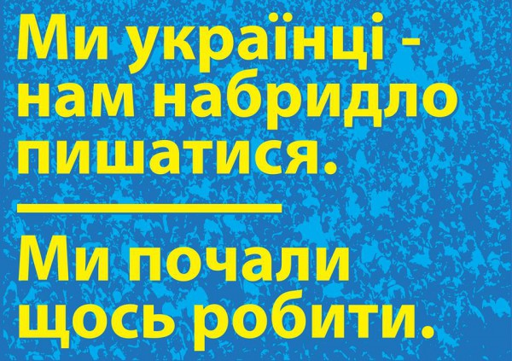
EUROMAIDAN IDENTITY
One of the most noteworthy consequences
of the recent events in Ukraine is a dramatic
change in Ukrainian national identity. In
various media one can regularly encounter assertions
of individuals’ increased self-identification
as Ukrainian, greater pride in being a citizen of
the Ukrainian state, stronger attachment to the
symbols of nationhood, enhanced solidarity
with compatriots, increased readiness to defend
Ukraine or work for Ukraine, and increased
confidence in the people’s power to change the
country for the better (Kulyk, 2016, p. 588).

Slide 3

Euromaidan values
Actually, the
above-mentioned dominant values of Maidan
give an understanding of what a “Revolution
of Dignity” means and consists of: 1) creativity,
freedom, independence, self-esteem, curiosity –
Self-direction; objectivity, integrity, compassion,
loyalty, responsibility – Benevolence; 3) wisdom,
social justice, equality, peace, beauty, tolerance,
unity with nature, protecting the environment –
Universalism (Sviatnenko Vynogradov, 2014,
p. 49).

Slide 4


Slide 5
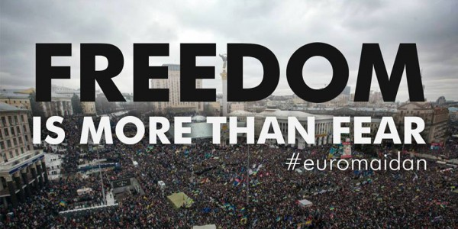
Language as source of identities and values
…language always
occurs in some kind of context, including
cognitive contexts in which past experience and
knowledge is stored and drawn upon, cultural
contexts consisting of shared meanings and
world views, and social contexts through which
both self and others draw upon institutional
and interactional orders to construct definitions
of situation and action (Schiffrin, 1987, p. 4).

Slide 6
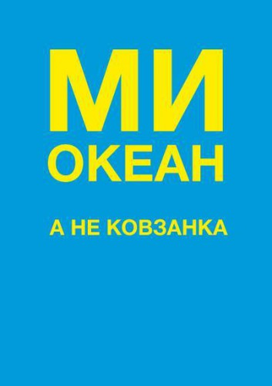
Identities vs values
During the last few years me and my colleagues
have been saying that Ukraine has significantly
more serious problems not with its identities, but
with its values; because identities in Ukraine, no
matter how, ensure its existence as a stable political
community. However, a set of values which
the majority of Ukrainian population shares –
and it does not matter where, on the West or on
the East – does not allow introduce any radical
political and economic reforms in Ukraine. These
are the values of a so called “closed society”
where the feeling of fear and distrust are dominant,
and the main wish of inhabitants is to find
a safe place for themselves and their families
(Hrytsak, 2014, p. 93).

Slide 7

TYPES OF EUROMAIDAN IDENTITIES
Political identity
Grass-root initiatives Identity
National civic identity
European identity
Regional identity
Gender identity
Group identity

Slide 8
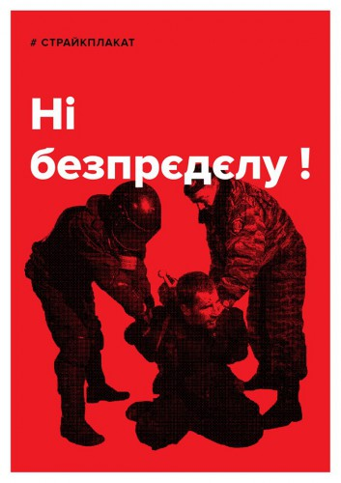
Motivation of maidan people
Among the motives that induced
people go to Maidan three proved to be the most
prevailing: a violent beating of demonstrators
on Maidan in the night of November 30 and
repressions (70%), Victor Yanukovych’s refusal
to sign the EU-Ukraine Association Agreement
(53,5%), and a desire to change life in the country
(50%). Intentions to change public authorities
in Ukraine were also rather strong (39%). Calls
of the opposition were a stimulus for 5%, and
the same percentage of people claimed to join
Maidan to take revenge of authorities for their
actions (Maidan 2013).

Slide 9
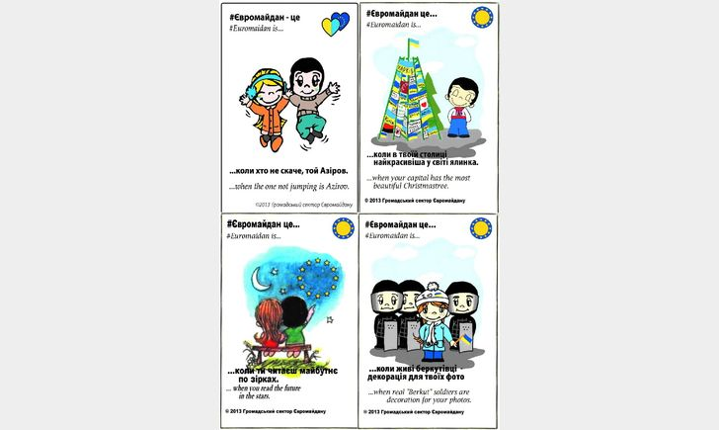
MAIN Euromaidan values
Value of Love
Value of Freedom
Value of Solidarity

Slide 10
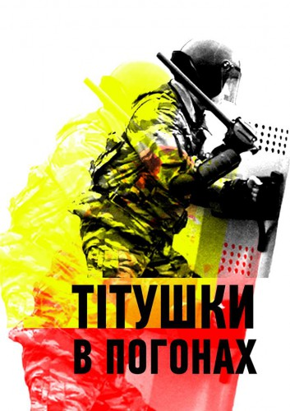
Rhetoric of antimaidan
In a special way a Maidan identity was created, and its values were crystallizing in a constant opposition to the purposes of participants on the other side of barricades – public authorities, Berkut riot militia, titushkas, and antimaidaners. Which were the mottos on the opposite side of the barricades? Contrary to the individualized creativity of the Maidan slogans, they were more typical and isolated. To give some examples, many participants of Antimaidan were holding the same printed placard Stop Maidan of the same format; whereas among the Maidan slogans were those that were more and less popular, some used by individuals and some by groups. With that in mind, the community called “Strike Placard” uploaded to the Internet a device which enables to download and print out a poster, but it was also possible and desirable that the users add their own words to a poster. For example, various beginnings of a phrase were suggested - I go for those who…; I go to…; I go because…, and the protesters were finishing the phrases by themselves, printing placards and coming with them to the protest – I go to get a sweet life outside Mezhyhirja (Yanukovych’s residence, nowadays a so called “museum of corruption”); I go because freedom is above all!; I go because we worth it; I go because I hate regionals (representatives of the political party of Regions). I would like to shoot them!; I go for the future of my future kids!; I go for those who are already not with us and for those who will be born later. In such a way a common idea received an individual expression that underlined the main values of the community – freedom and dignity.

Slide 11
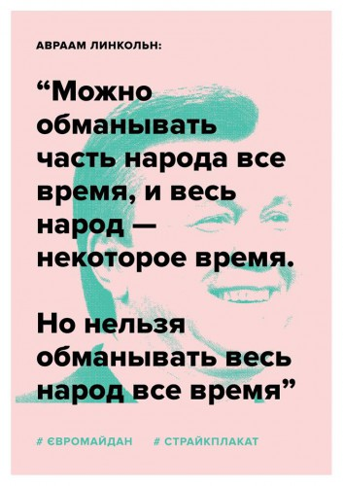
Anti-Russian maidan rhetoric
In that period, the anti-Russian rhetoric was also developing. This rhetoric was partially manifested already during Euromaidan in the slogans Russia is for sad people (the original text is in Russian); I was sucked by a dangerous Russia and my life is a never-ending pipe (the original text is in Russian). However, this rhetoric was naturally intensified after Crimea annexation and the war that was started in Donbas – Putler (which is a wordplay, a mixture of Putin and Hitler), Stop lying and killing! Death to Russian occupants! (the original text is in Russian); Close the boarders with Russia immediately!; Stop Russian terrorism! During Crimea annexation, the placard with the image of matryoshkas, stylized as Russian soldiers, appeared with the inscription – Go home! (the original text is in English). Anti-Russian slogans are directed against the lie of Russian propaganda and the Russian aggression in Ukraine, therefore, the concept of Russia in it refers to the Putin’s regime, the state system, not to the Russian people in general. These slogans are mainly formulated in English to attract attention of the global community - Mariupol still says “no” to Russian occupation; Russia makes war, not peace. The Russian invasion of Ukraine 2014–2015; Russia, wake up, you’re drunk; Stop Russian occupation. On the other hand, on the pro-Russian meetings in Crimea, as well as in Donbas, the call Russia! was sounding.

Slide 12
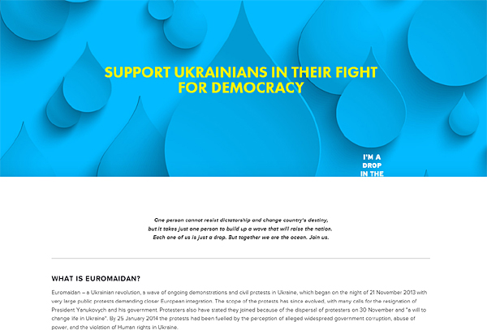
literature
1. Kulyk, V. (2016). National Identity in Ukraine: Impact of Euromaidan and the War. Europe-Asia Studies,vol. 68(4), pp. 588–608.
2. Schifrin, D. (1987). Discourse Markers. Cambridge: Cambridge University Press.
3. Sviatnenko, S., Vynogradov, A. (2014). Euromaidan Values from a Comparative Perspective. Social, Health and Communication Studies Journal. Contemporary Ukraine: A Case of Euromaidan, vol. 1(1), pp. 41–61.
3. Taniguchi, S. (2010). Transforming Identities In and Through Narrative. In: D. Nunan, J. Choi (eds.), Language and Culture. Reflective Narratives andthe Emergence of Identity. New York & London: Routledge.
4. Блудша, М. (2014). Правий вектор Майдану – провокатори і герої // Е-ресурс: http://ua.racurs.ua/450-pravyy-vektor-maydanu-provokatory-igeroyi.
5. Булатов, Д. (2014). Государство – это мы с вами / Майдан. (Р)еволюція духу: мистецько-культурологічний проект / Автор і куратор проекту: Антін Мухарський. – К.: Наш формат.
6. Гаврилюк, М. (2014). Я не хотів, що моя дитина була рабом / Майдан. (Р)еволюція духу: мистецько-культурологічний проект / Автор і куратор проекту: Антін Мухарський. – К.: Наш формат.
7. Грицак, Я. (2014). Україна витримає і це випробування / Майдан. (Р)еволюція духу: мистецько-культурологічний проект / Автор і кураторпроекту: Антін Мухарський. – К.: Наш формат.
8. Десятерик, Д. (2014). «Таке відчуття, що політкампаніями у нас займаються тисячі Остапів Бендерів, яких хтось образив». Інтерв’ю з авторами плаката ≪Я – крапля в океані, який змінить країну≫ // Газета ≪День≫. – 21 березня 2014 р. // Е-ресурс: http://www.day.kiev.ua/uk/article/kultura/take-vidchuttya-shcho-politkampaniyamiu-nas-zaymayutsya-tisyachiostapiv-benderiv
9. Майдан–2013: хто стоїть, чому і за що? (2014). Е-ресурс: http://dif.org.ua/ua/events/gvkrlgkaeths.htm.
10. Матузкова, О. (2014). Ідентичність як структура // Наукові записки НаУКМА. Філологічні науки. – Т. 164. – К., 2014.
10. Портнов А. Українська “Еврореволюція”. Деякі спостереження / Майдан. (Р)еволюція духу: мистецько-культурологічний проект / Авторі куратор проекту: Антін Мухарський. – К.: Наш формат
11. Ройтбурд, О. (2014). FB-щоденник. Вибране. Майдан – 2013–14 / Майдан. (Р)еволюція духу: мистецько-культурологічний проект / Авторі куратор проекту: Антін Мухарський. – К.: Наш формат.
12. Семесюк, І. (2014). Ґонзо-щоденник лютого україножера / Майдан. (Р)еволюція духу: мистець-ко-культурологічний проект / Автор і куратор проекту: Антін Мухарський. – К.: Наш формат.
http://afisha.bigmir.net/exhibition/articles/208977-God-Evromajdanu--30-plakatov--kotorye-ushli-v-narod
http://wz.lviv.ua/cartoon/125059-evromajdan-tse-koli-khto-ne-skache-toj-azirov
http://life.pravda.com.ua/society/2014/02/13/152183/

Slide 13

Thank you for your attention!

